Slide 1
Analysis of Uber & Lyft ride details
presented by - vishnu

Slide 2
CONTENTS
Data info
Objective of analysis
Eda results
Critical observations
Feature selection
Model selection and accuracies
Conclusions
Future improvements

Slide 3
DATA INFO
Data source – Kaggle.
Data set size – around 300 MB.
Time bound of data – November and December 2018.
Location - Boston, USA.
Details – It contains 57 features(trip details and weather) and 690 K instances.
Few features – time and date, source, destination, distance, price, cab type and weather details at that time.

Slide 4
OBJECTIVE OF ANALYSIS
GOAL – To predict the price of trip and finding key features in pricing dynamics.
Target variable – Price.
Observing trends related to price.
Do weather details affect pricing dynamics?
Is it possible to obtain better accuracy?

Slide 5
EDA
Null values – 55 K (price), after dropping null values data frame shape – 630 K rows and 57 features.
Duplicate values – 0.
Uber – 52%, Lyft – 48%.
Distributions
Hours – almost balanced.
Cab type – balanced.
Sources, destinations – balanced.
Weather situation – unbalanced.

Slide 6
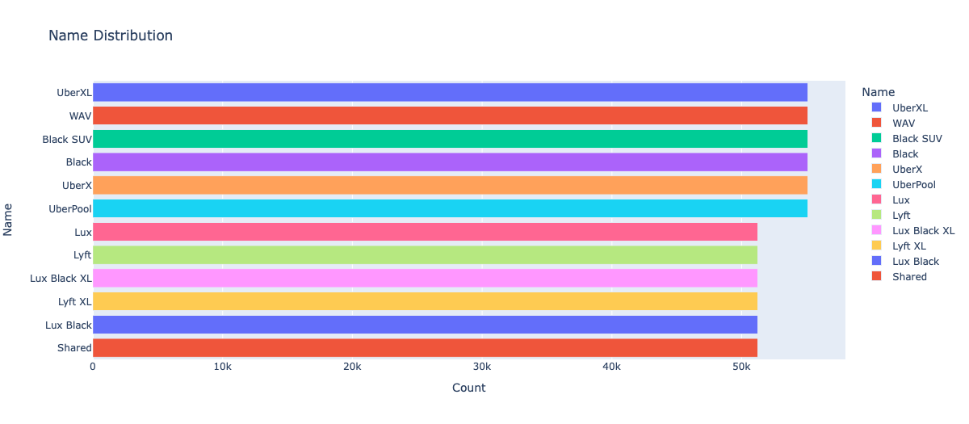

Slide 7
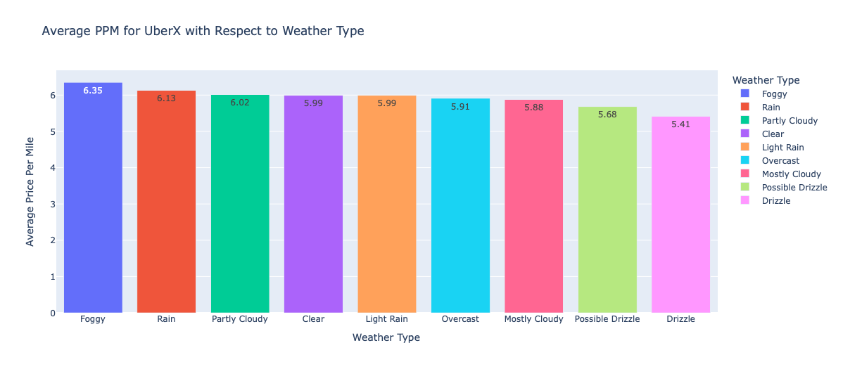
OBSERVATIONS – PRICE PER MILE

Slide 8
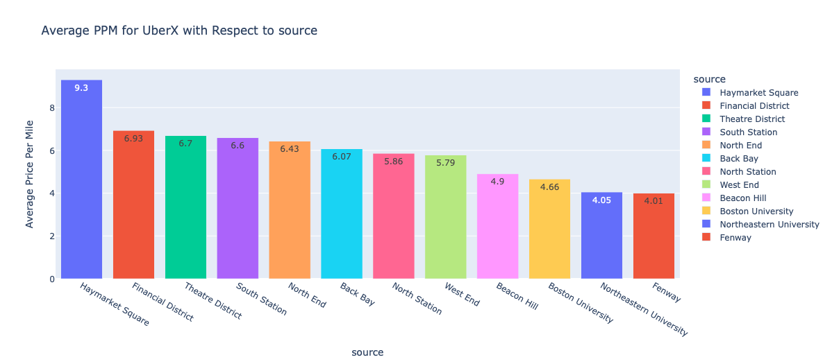

Slide 9
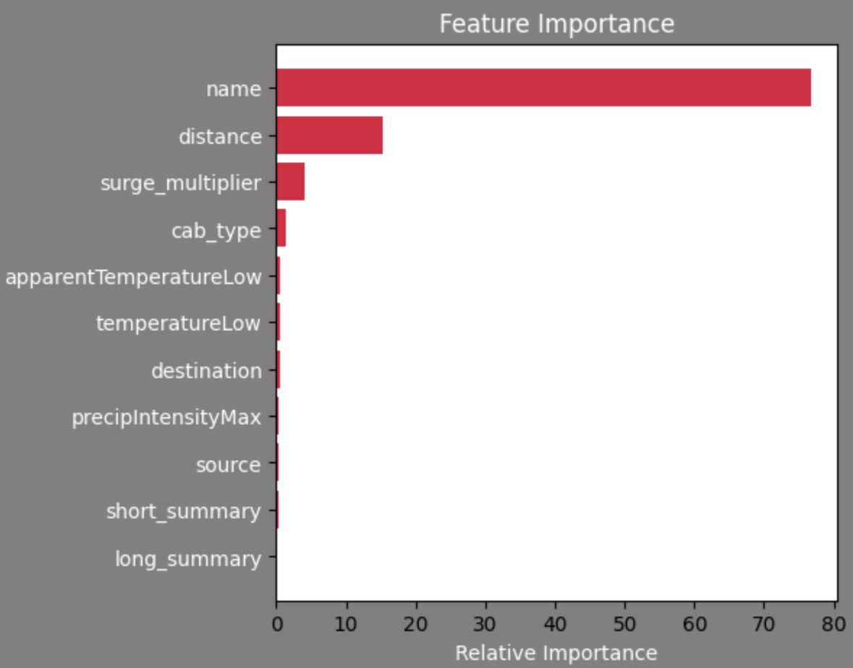
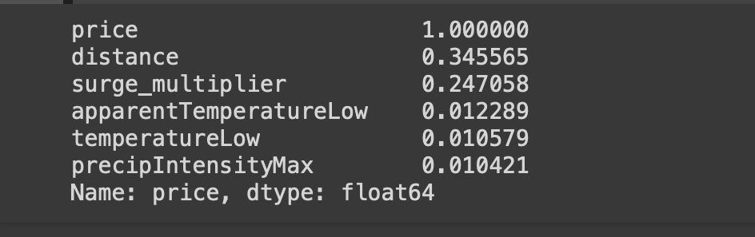
FEATURE SELECTION

Slide 10
MODEL SELECTION
Key Features
Cab name – categorial
Distance – continuous
Surge multiplier – continuous
Source & destinations – categorical(for this dataset)
Temperature and prep intensity - continuous
What should I do now?
Which model should I chose?

Slide 11
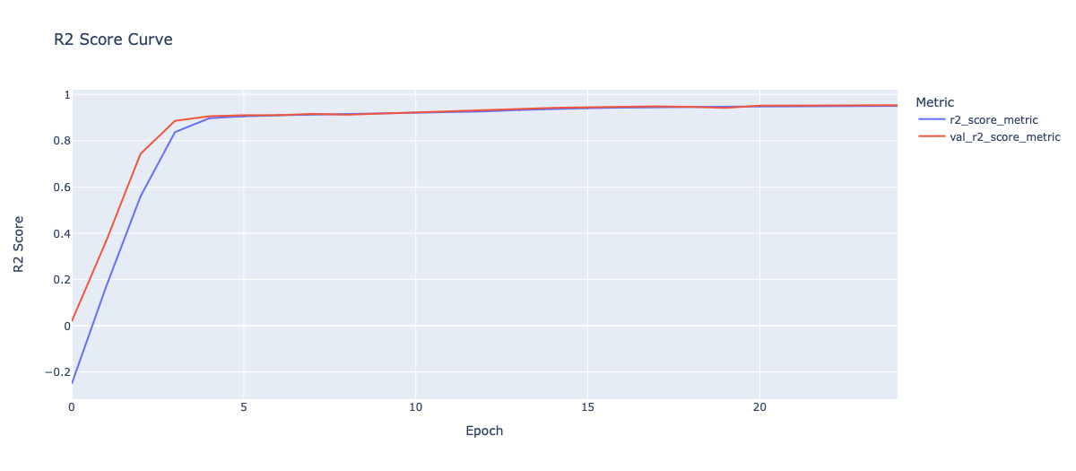
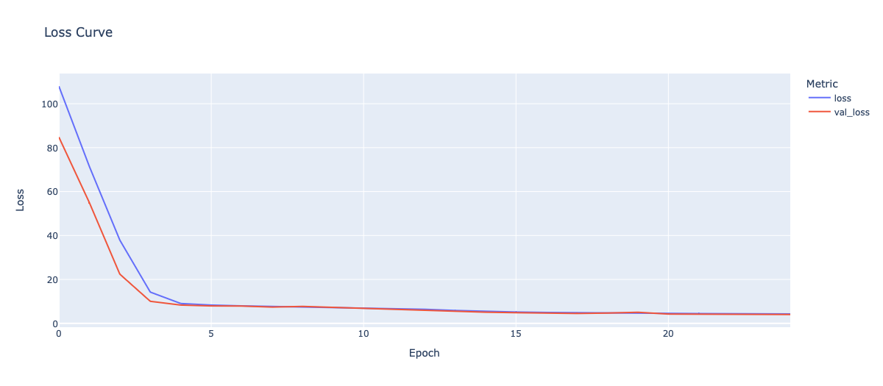
ACCURACY
Linear regression
Training R2 score – 92
Testing R2 score – 92
NN
Training
R2 score – 95
MSE loss – 4.2
Validation
R2 score – 95
MSE loss – 4.0

Slide 12
CONCLUSIONS
Well, results seem good.
Data over almost every feature balanced except weather condition.
Even using linear regression gives 92 R2 score.
Through observation, weather and starting places changes the price dynamics.

Slide 13
FUTURE IMPROVMENTS
Time bound
Data quality
Data requirements
Time complexity
Accessing distance and time from more real situations.
Using streamlit!

Slide 14
Thank you

